Slide 1
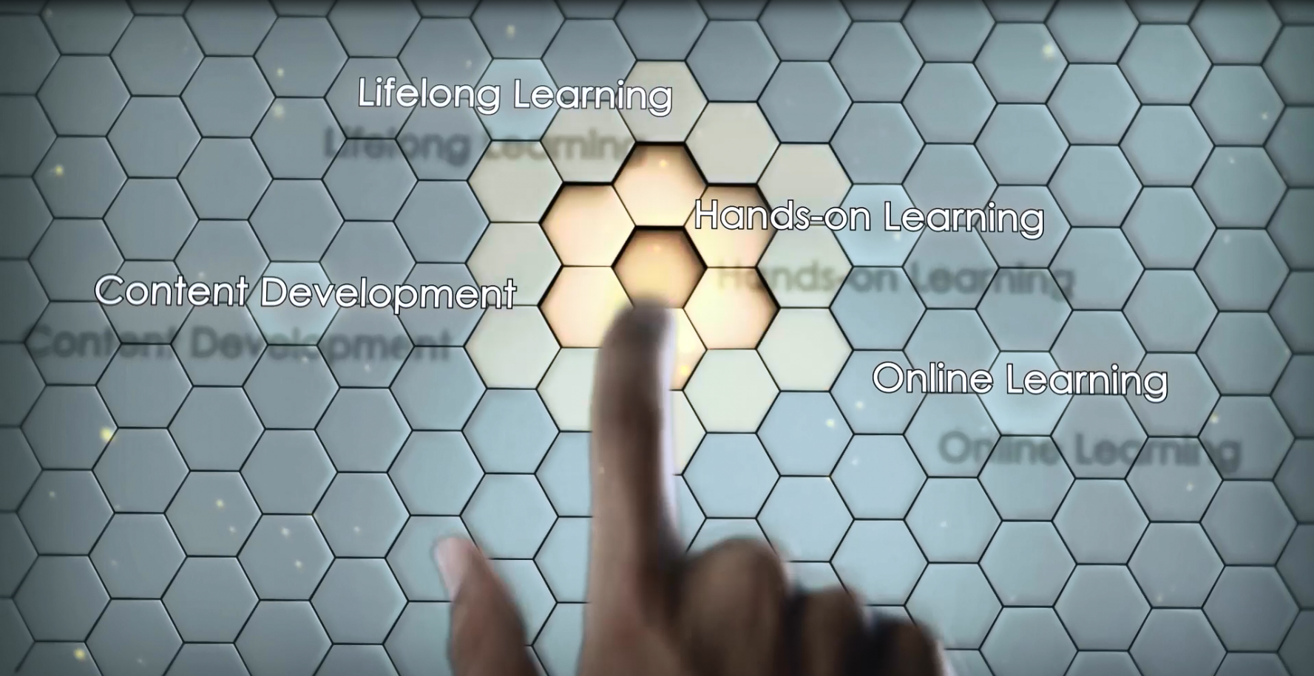
For Slide 1 and 2 do like Sasbadi Holdings corporate video

Slide 3
Some shots of EV3 projects and Tetrix
(from tetrix promo video and Ev3 projects)
Background music

Slide 4
- The lecturer interview shot
-shot in lecture hall
-Class environment
-Lab environment
My name is _____________. I am lecturer at Universiti Teknikal Malaysia Melaka (UTEM), I teach ___________ here. Practical classes are becoming more important nowadays; learning becomes so much more effective when we translate theory into a hands-on experience. That’s what LAB Solutions gives us.

Slide 5
-Student do coding (zoom in)
-student set it to a robot
- The robot move (simple movement)
For IT classes, my students get excited and motivated when they apply their coding to a robot and see it move. The best thing about Lab Solutions - It is compatible with many coding languages such as C++, Java, Labview, Mathlab, VB and many more.

Slide 6
-Students using tools such as screwdriver and tighten the parts
-a few robots
-students test the robot
As for engineering subjects, students are able to construct machines with simple but sturdy parts from Textrix, PITSCO. The parts are easy to put together and dismantle. This really adds a new dimension to developing their creativity and imagination; their critical thinking and problem solving skills.

Slide 7
-the student (interview session)
My name is ______________. I’m a_____ year student in _______________.
I’ve been using Lab Solutions for ___ years now.

Slide 8
-NURC bunting or banner
Recently we won 2nd place in the National University Robotics Competition (NURC), which also means we have the opportunity to represent Malaysia at the World Robot Olympiad (WRO) being held in New Delhi in November 2016.

Slide 9
-The team at NURC
- Shots from NURC
For the NURC, we created a bowler robot for the Bowling themed competition. The challenge was not easy, we have to pre-programme our robot to tackle the challenge. revise

Slide 10
-Prize giving ceremony in NURC
Other teams did great too, especially the teams from UTARC and UTP. During the final round our robot managed to drop some bowling pins that resulted us as the 1st runner up. revise We definitely will do better at WRO India.

Slide 11
-Interview shot – Hazrul
- EV3 box and TETRIX Box
Hazrul: Lab Solutions consists of 2 main sets: EV3 LEGO Mindstorm and TETRIX, PITSCO. *check - isn’t lab solutions from National Instrument?

Slide 12
-Interview shot – Hazrul
- EV3 components
The controller or the robot’s brain is by EV3 LEGO Mindstorm, it is compatible with _______________.
It has _________________ functions?
The set comes with various sensors such as __________, ______________, __________. It is open source? *more depth into this

Slide 13
-Interview shot – Hazrul
TETRIX, PITSCO components
- Demo showing of how easy to put the parts together
TETRIX parts come in a box. The parts are made from ________ with a quality standard that is sturdy enough to support ____kg of weight. Best of all, they are easy to put together and dismantle, suitable for engineering and IT students. *generalize it to a wider range of students and subjects to materialize their ideas and theories.

Slide 14
-Interview shot – Hazrul
- TETRIX, PITSCO components
*continue* TETRIX parts come in a box. The parts are made from ________ with a quality standard that is sturdy enough to support ____kg of weight. Best of all, they are easy to put together and dismantle, suitable for engineering and IT students. *generalize it to a wider range of students and subjects to materialize their ideas and theories.

Slide 15
-Interview shot – Hazrul
Some shots from classroom, students putting it together, zoom in to the boxes.
Hazrul: Lab Solutions was created to facilitate learning, it really brings understanding and exploration to a whole new level for students. Universities absolutely should take advantage of this technology.

Slide 16
-the lecturer (interview session)
- Robots with some real function
Lecturer: There are several studies that have been done to show the benefits of learning by doing. It gives new meaning to the idea of learning; subjects related to maths and science are often abstract, so when students physically experience the concepts they are learning, they process the information better, which in turn delivers better results.

Slide 17
-the lecturer (interview session)
- Robots with some real function
Lecturer: The world is changing at an astonishing pace. Technological advancements in the past 2 decades alone have brought wonderful changes to the world, and we can only expect more to come. But these changes come along with challenges as well, and we must prepare and provide students with the skills they will need to succeed in the future.

Slide 18
LEGO EV3 Mindstorm logo
TETRIX PITSCO logo

